Slide 1

Enterprise Architecture Heat Maps Initiative
I&T Division Service Model
April 19, 2010
(with minor updates)

Slide 2
Agenda
Background and Service Concepts Confirmation
I&T Clients and Needs Review
I&T Services Model Review
Next Steps

Slide 3
Project Background
  Heat map exercise initiated to support business and technology planning decisions
  Work has been completed for 17 divisions
  Remaining Divisions are being completed
  I&T is next on the list of divisions to been done
  Model review and confirmation with Directors and Managers completed

Slide 4
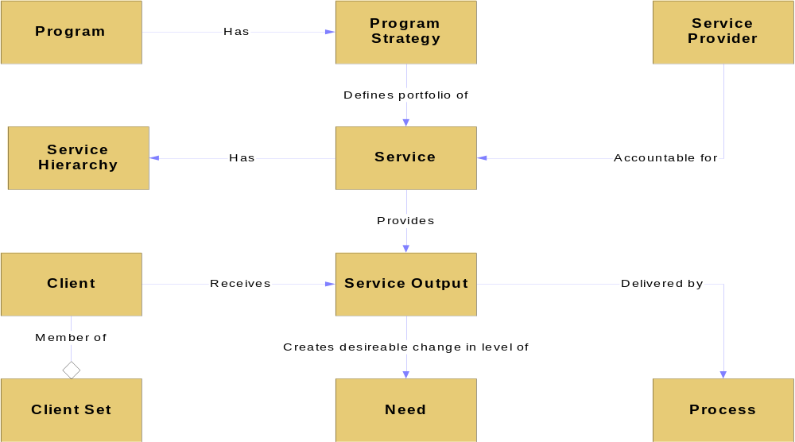
Elements of a Service

Slide 5
“Services” view of an enterprise
Types of services:
  Public services provide outputs that meet the needs of public clients.
  Internal services provide outputs that meet the needs of program managers and service providers within the municipality.
Management tasks:
Add value by contributing to the delivery of the final valued output.
Are tasks that support the delivery of more that one service
Include management structures (e.g. governance) to ensure that services are efficient, effective, and high quality

Slide 6
Criteria for Service Definition
Completeness – services should provide a complete solution to Client’s needs
Separability – a well defined service should not depend on other services for its existence.
Service Offerings – generally variants of a service should not be treated as separate service offerings (e.g. motor cycle versus passenger vehicle drivers licensing service).
Access and Delivery Channels – the use of different “channels” to provide access to a service does not constitute a new service offering (e.g. over counter, by phone or internet).
Single Output – a service should have one major output. A service with multiple outputs should be split into several services.
External Client – services by definition deliver outputs to clients outside the boundary of the enterprise. Processes deliver outputs to ‘clients’ within the enterprise.
Formal Interface – a formal service offering requires a formal interface to transact with potential clients. The service interface provides a mechanism for the client to request services and to receive the service outputs.

Slide 7
I&T Division Clients
Direct Clients:
  Divisions (City of Toronto)
    Business Operations
    Divisional IT
    Staff
  City Councillors (e.g. web, communications)
  ABCs (some services only)
  Public (e.g. open data, web) (decision made on 4/19/2010 to park point as to whether Public
  is a direct client)
Indirect Clients
  Public
    Individuals
    Industry
    Business

Slide 8
I&T Division Client Needs
I & T Division View
Solutions to Support/Enable Business
Innovation and Continuous Improvement
Business Agility/Responsiveness to change
Staff Capability to leverage business solutions
Help/Support
Guidance/Advice
Client View
TBA

Slide 9
Information & Technology
Program Map (Current)
Information & Technology
(Program)
I & T Plan
(Service)
I & T Build
(Service)
I & T Sustain
(Service)

Slide 10
Information & Technology
Program Map (New)
Information & Technology
(Program)
Enterprise Strategy
(Service)
Solutions
(Service)
Hosting
(Service)
Consulting
(Service)
Training & Education
(Service)
Support
(Service)

Slide 11
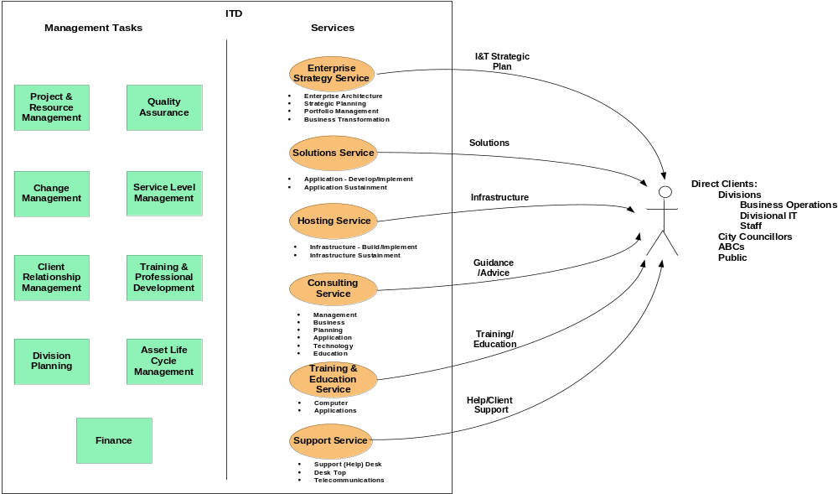
Summary: I&T Services

Slide 12
Needs/Service Cross Reference
(From Client Perspective)
Client Need | I & T Division Service
 | Enterprise Strategy | Solutions | Hosting | Consulting | Training | Support Services
Solutions to Support Business | X | X | X | X
Staff Capability to Leverage Business Solutions |  | X | X |  | X
Help/Support | X |  |  | X |  | X
Guidance/Advice | X |  |  | X
Business Agility/Responsiveness to Changes | X | X | X | X
Innovation and Continuous Improvement | X | X | X | X

Slide 13
Next Steps
Update Services Model
Complete Program Maps and Service Profiles
Confirm processes

Slide 14
Appendix A
Summary Service Profiles

Slide 15
I&T Division Services
Enterprise Strategy Service
Clients: Division Business Operations, Division IT, Division Staff, City Councillors, ABCs
Description: Provides the enterprise strategic plan and identifies opportunities for business transformation. Develops a blueprint framework of the enterprise architecture, manages the enterprise portfolio and develops strategic plan to optimize I&T resources and align with business objectives.
Sub-Services
  Enterprise Architecture
  Strategic Planning
  Portfolio Management
  Business Transformation
Output: I&T Strategic Business Plan
Needs:
  Solutions to Support Business
  Innovation and Continuous Improvement
  Business Agility/Responsiveness to change
  Guidance and Advice
  Help/Support

Slide 16
I&T Division Services
Solutions Service
Clients: Division Business Operations, Division IT, Division Staff, City Councillors, ABCs
Description: Delivers business solutions to Clients. Provides I&T application development and implementation services. Offers sustainment for applications. Provides common components to allow optimal use of technology in meeting business solutions.
Sub-Services
  Application Development / Implementation
  Infrastructure Build / Implementation
  Applications & Infrastructure Sustainment
Output: Solutions To Support Business
Needs:
  Solutions to Support Business
  Innovation and Continuous Improvement
  Business Agility/Responsiveness to change
  Staff Capability to Leverage Business Solutions
  Help/Support

Slide 17
I&T Division Services
Hosting Service
Clients: Division Business Operations, Division IT, Division Staff, City Councillors, ABCs
Description: Delivers hosting services to Clients. Included is Infrastructure build and deployment. Offers sustainment infrastructure.
Sub-Services
  Infrastructure Build / Implementation
  Infrastructure Sustainment
Output: Solutions To Support Business
Needs:
  Solutions to Support Business
  Innovation and Continuous Improvement
  Business Agility/Responsiveness to change
  Staff Capability to Leverage Business Solutions
  Help/Support

Slide 18
I&T Division Services
Consulting Service
Clients: Division Business Operations, Division IT, City Councillors, ABCs
Description: Provides I&T consultancy services regarding management, business, planning, application, technology and education issues.
Sub-Services
  Management
  Business
  Planning
  Application
  Technology
Output: Guidance/Advice
Needs:
  Guidance and Advice
  Innovation and Continuous Improvement
  Business Agility/Responsiveness to change
  Solutions to Support Business
  Help/Support

Slide 19
I&T Division Services
Training & Education Service
Clients: Division Business Operations, Division IT, Division Staff, City Councillors, ABCs
Description: Provides IT training and education of business users. This service includes the development of divisional IT training plans, IT training requirements, computer training and applications training.
Sub-Services
  Computer Training
  Application Training
Output: Training & Education
Needs:
  Staff Capability to Leverage Business Solutions

Slide 20
I&T Division Services
Support Service
Clients: Division Business Operations, Division IT, Division Staff, City Councillors, ABCs
Description: Provides help and support to the client in accessing and consuming I&T services. This includes Tier 1 and Tier 2 support for the Help Desk, Desk Top, Telephone, Wireless Telecommunications. Included is support for telecommunications, data network infrastructure, server/storage and infrastructure management.
Sub-Services
  Help Desk
  Desktop Support
  Telecommunications (e.g. telephone, wireless communications, voice mail)
Output: Help/Support
Needs:
  Help/Support

Slide 21
Appendix B
Summary Management Task Profiles

Slide 22
I&T Management Tasks
Project & Resource Management
Quality Assurance
Change Management
Service Level Management
Client Relationship Management
Training & Professional Development
Planning
Asset Lifecycle Management
Finance

Slide 23
I&T Management Tasks
Project & Resource Management
Provides Project Management to deliver effective management of information and technology projects throughout the organization supported by a consistent project management framework and methodology.
Sub-Tasks
  Project Governance
  Project Delivery
  Resource Management

Slide 24
I&T Management Tasks
Quality Assurance
Develops and sustains quality assurance standards, policies, procedures, an best practice
Sub-Tasks
  Quality Assurance
  Test

Slide 25
I&T Management Tasks
Change Management
Develops and sustain change management standards, policies, procedures and best practice
Sub-Tasks
  Change Management
  Release Management

Slide 26
I&T Management Tasks
Service Level Management
Provides support for the development, identification, monitoring, and review of performance related to I&T services captured in Service Level Agreements (SLA'S).
Sub-Tasks
  SLM Planning
  SLM Implementation
  SLM Sustainment

Slide 27
I&T Management Tasks
Client Relationship Management
Manages the relationship between business divisions and the I&T Division to support and create mutual value for clients. Aligns information and technology services to client needs and to improve business results.
Sub-Tasks
  Division Planning
  Service Management Engagement
  Opportunities and Delivery
  Issues Escalation and Management

Slide 28
I&T Management Tasks
Training & Professional Development
Provides training for Infrastructure, Enterprise Architecture and Information Architecture within the I&T Division.
Sub-Tasks
  Infrastructure Training
  EA Training
  Information Architecture Training

Slide 29
I&T Management Tasks
I&T Planning
Provide an enterprise framework of enterprise architecture, strategic, information and security plans, policies, standards and methods to ensure alignment of information and technology services with industry best practices.
Sub-Tasks
  I&T Enterprise Architecture Planning
  I&T Strategic Planning
  I&T Information Architecture Planning
  I&T Security Planning

Slide 30
I&T Management Tasks
Asset Lifecycle Management
Provides regular refresh of networks, hardware and software prescribed in the I&T Asset Lifecycle Plan. Keeps the City currently on warranty, maintenance and security updates.
Sub-Tasks
  Monitor Assets
  Plan Assets
  Define Asset Requirements
  Identify Asset Service Levels
  Cost Assets

Slide 31
I&T Management Tasks
I&T Finance
Provides information and guidance to corporate I&T Division in budgeting for I&T investments. Establishes a well-defined budget process for both capital and operating budgets for the I&T Division. Provides accounting processing to corporate I&T Division. Provides payroll and administrative processing to corporate I&T Division. Establishes a framework and procedures for RFPs, RFQs for corporate I&T. Provides contract administration processes for the corporate I&T Division.
Sub-Tasks
  Budgeting
  Accounting
  Payroll and Administration
  RFPs and RFQs
  Contract Administration

Slide 32
Thank You!

